Slide 1
Thursday, August 3, 2017
Write In Your Agenda:
Write In Your Monitoring Log:
CW:
Review Volume Lab
Metric monster overview
Super Scientists Worksheet
Draw A Scientist
HW:
Metric Monster
-rough=Tues., 8/8
-final=Mon, 8/14
Response to Warm-Up:
Describe one method that can be used to determine volume.
You will need:
Pencil
Agenda
Metric System Note Sheet

Slide 2
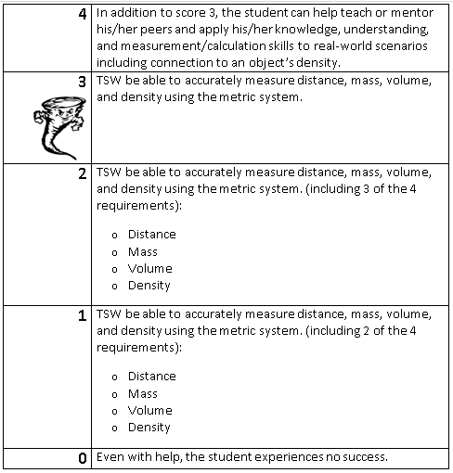
Learning Goal and Scale
TSW be able to describe how the Earth is connected to and affected by other objects in the solar system (including its movement, its relative position to other objects, its seasons, and visible constellations).

